Slide 1
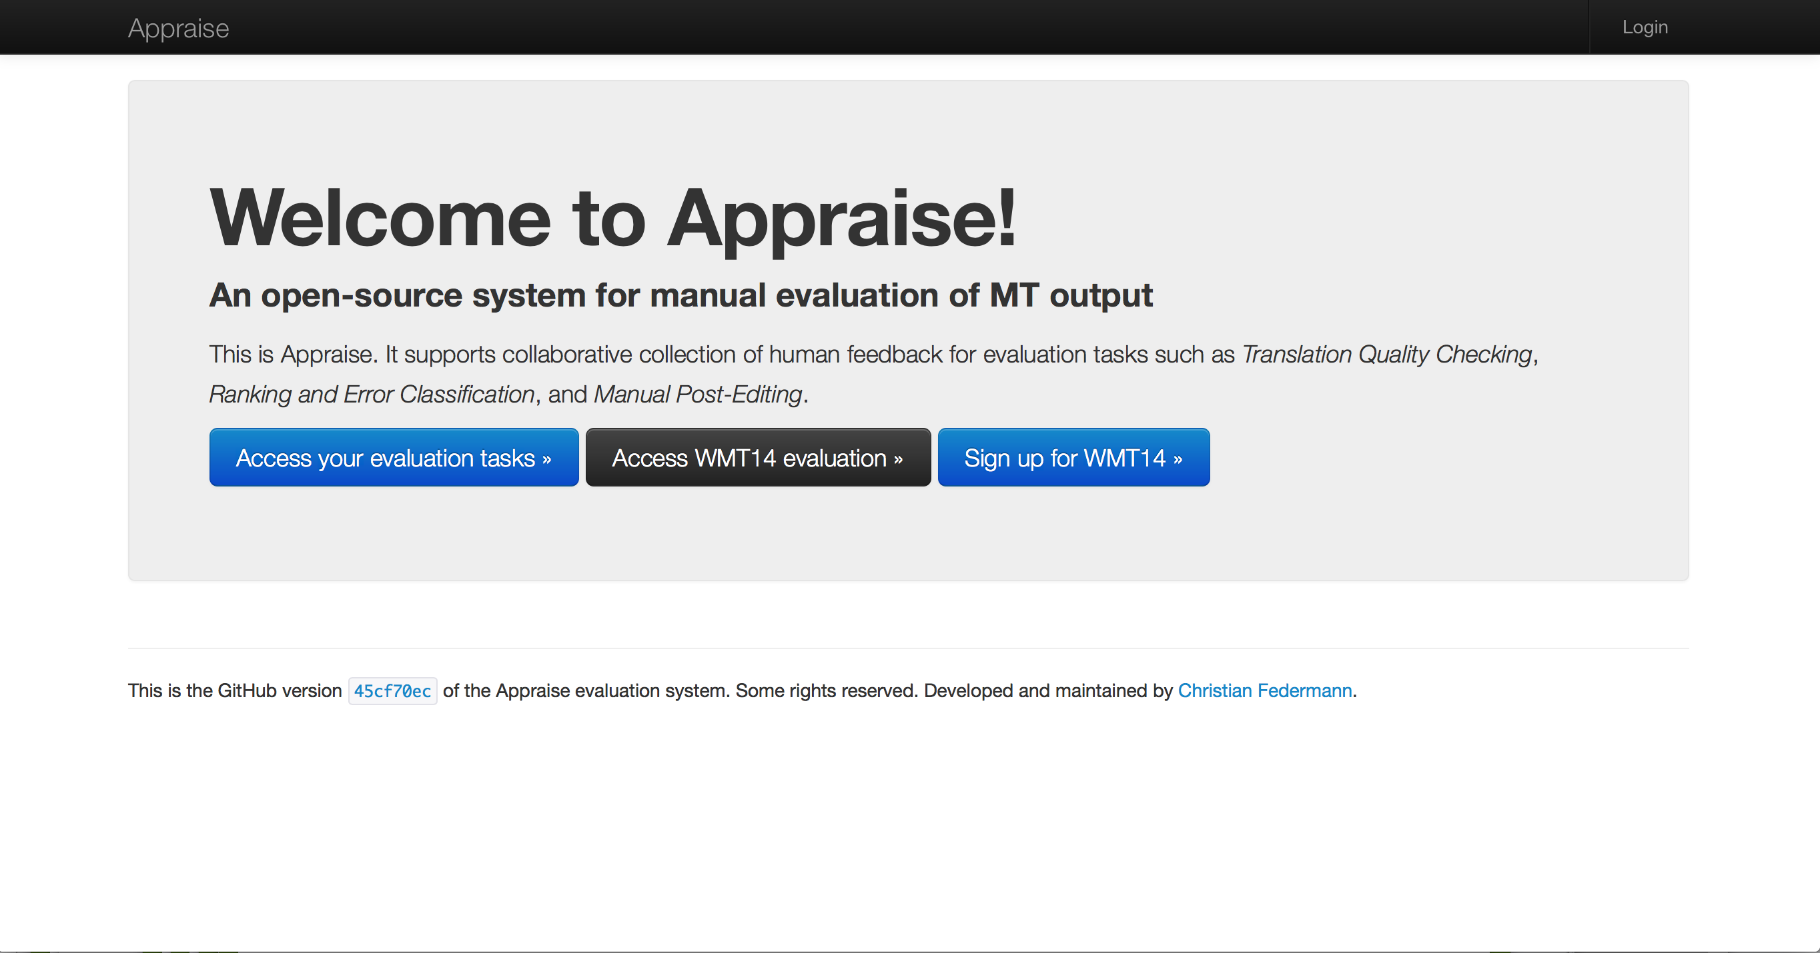
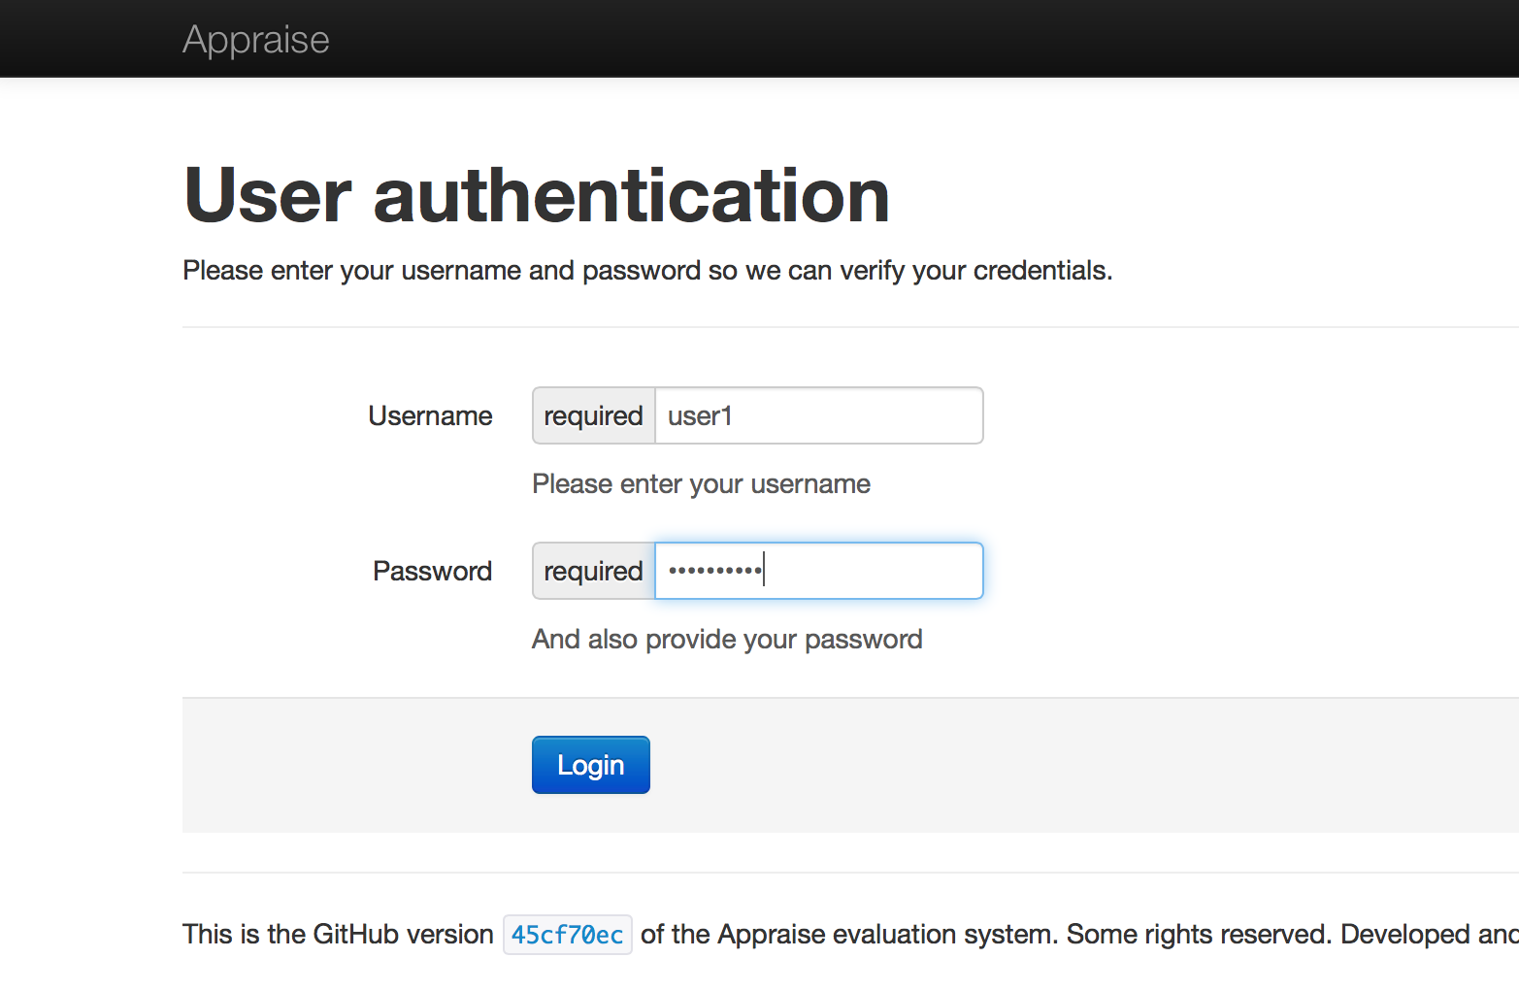
User Interface: Log in

Slide 2
Eye-Tracking Experiment
Tutorial

Slide 3
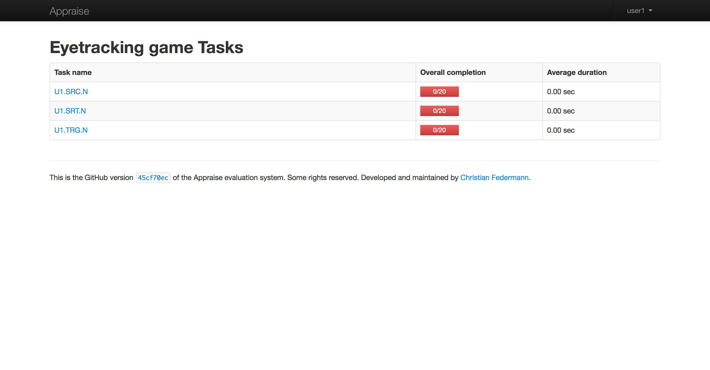
3 Tasks Screen:
20 sentences per task
Task 1
Task 2
Task 3
Click on Task 1. Time is measured, so do not interrupt it. You can rest after its completion.
Click on Task 2. Time is measured, so do not interrupt it. You can rest after its completion.
Click on Task 3. Time is measured, so do not interrupt it. You can rest after its completion.

Slide 4
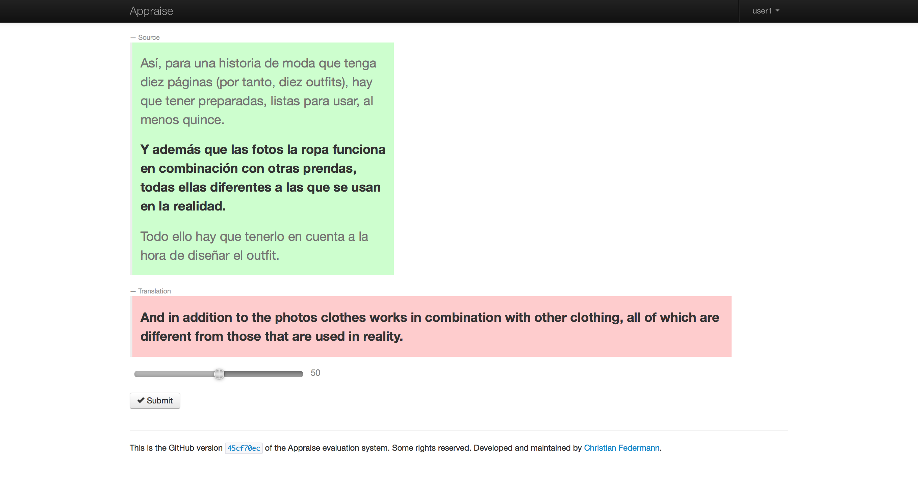
Task 1: You can see the:
Machine-Translated sentence to evaluate (in English) and the Original text (in Spanish)
Move the slider to evaluate

Slide 5
Task 1: You can see:
The Machine-Translated sentence to evaluate (in English) and the Original text (in Spanish)
Original sentence
context
Original sentence
Translated sentence
Move the slider to evaluate
Evaluation
slider

Slide 6
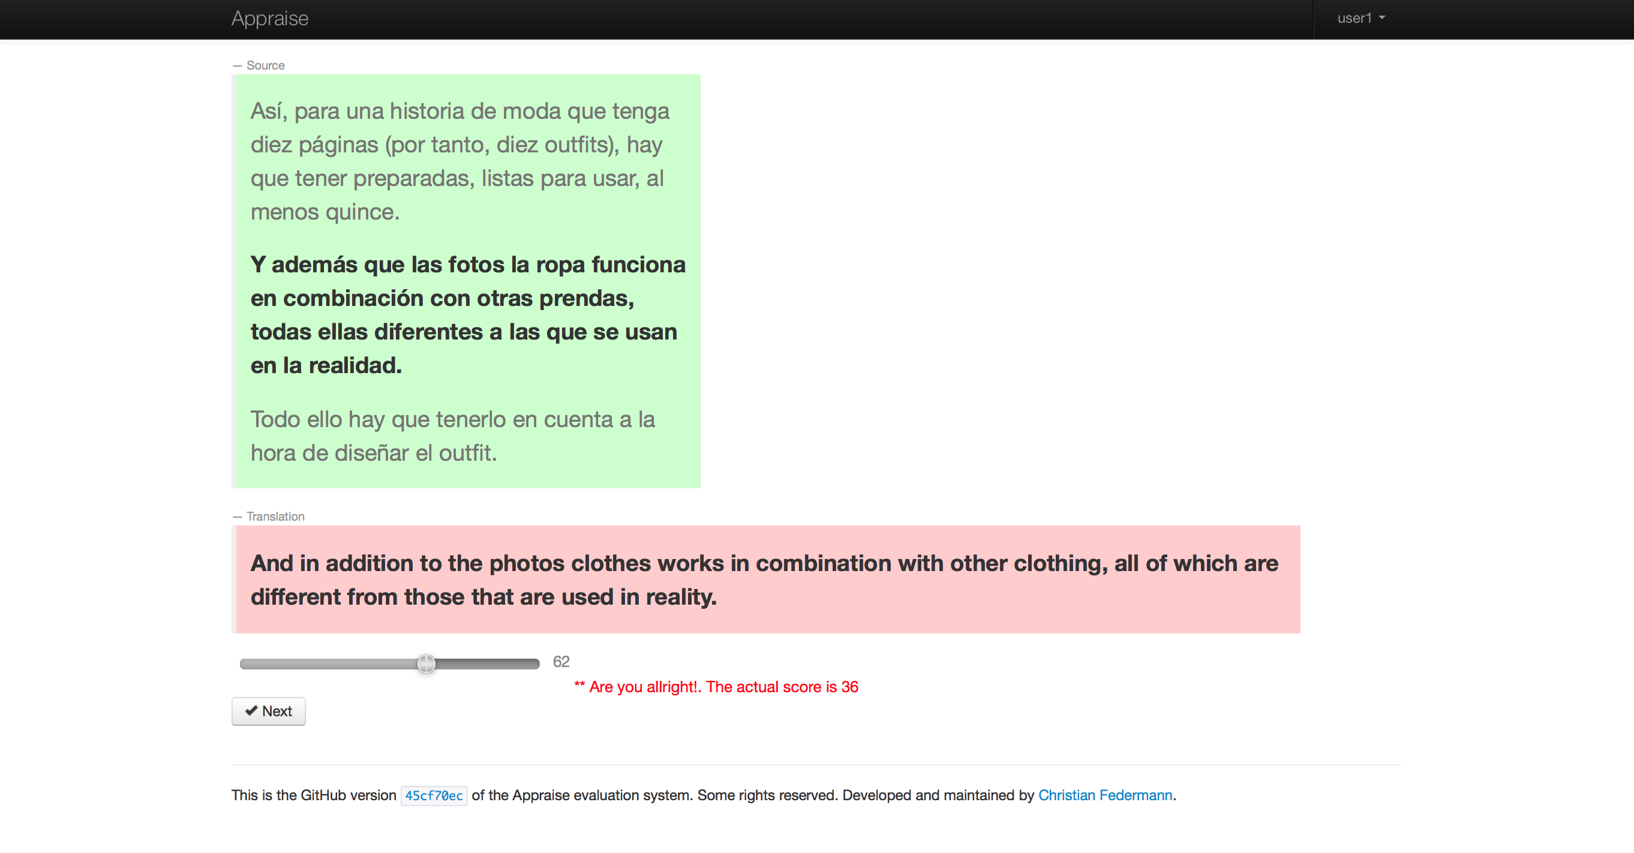
Task 1: After moving the slider:
Click on “Next” to go to the next sentence.

Slide 7
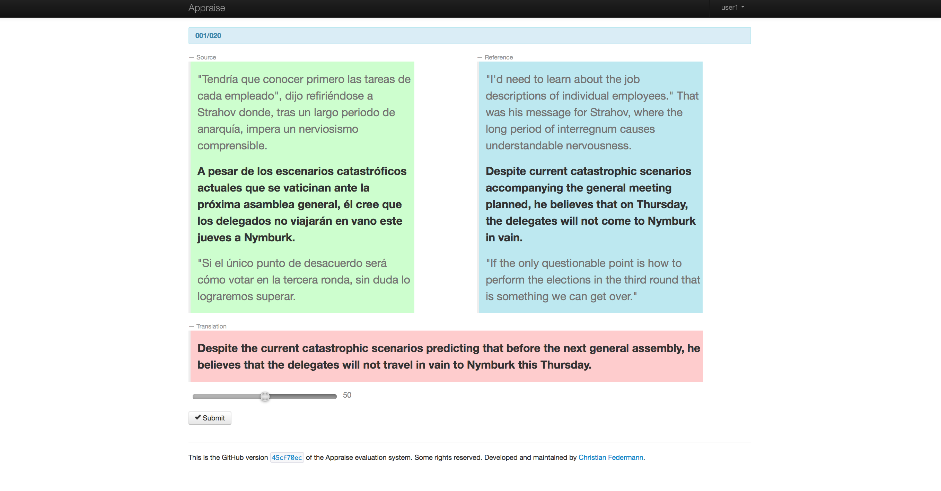
Task 2: You can see:
The Machine-Translated sentence to evaluate (in English), the Original text (in Spanish), and the Reference translation

Slide 8
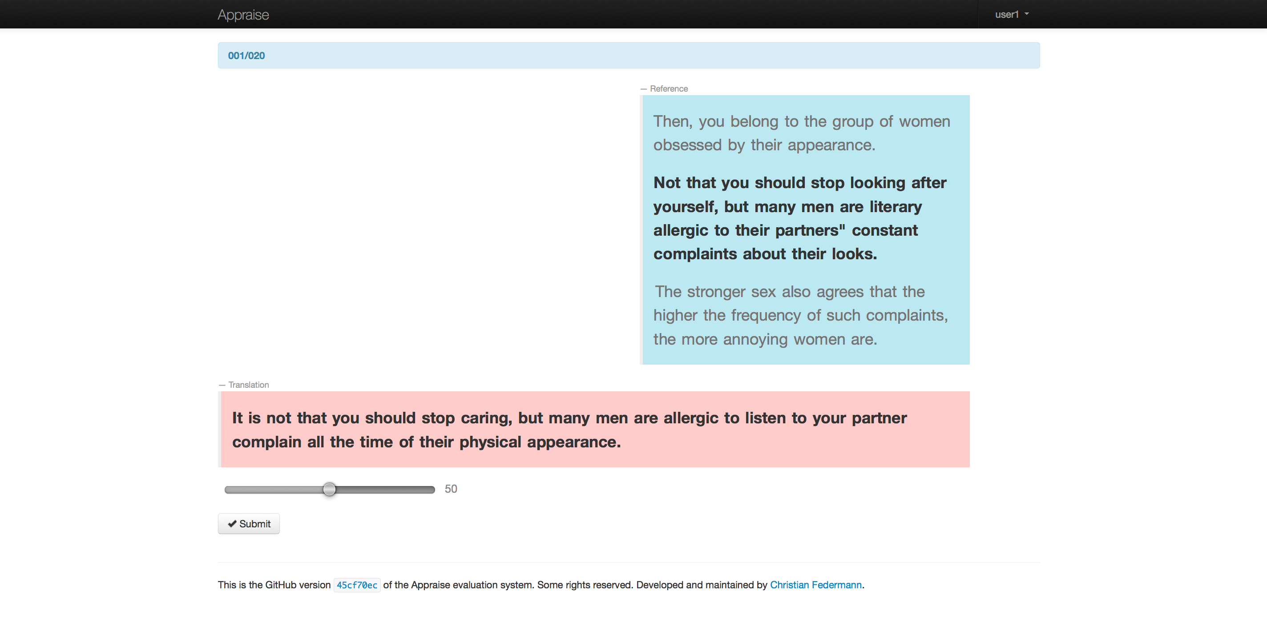
Task 3: You can see:
The Machine-Translated sentence to evaluate (in English) and the Reference translation

Slide 9
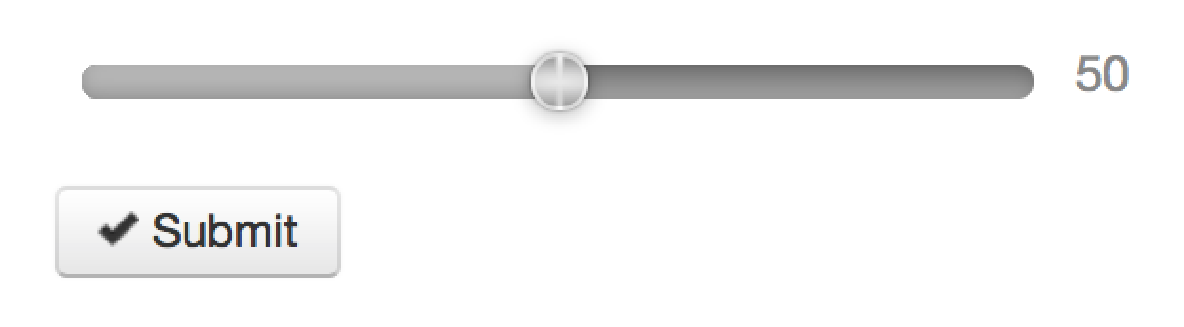
Training: 2 sentences per task

